Slide 1
Minerals and Rocks as Resources

Slide 2
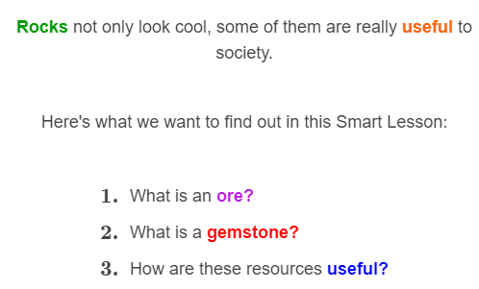
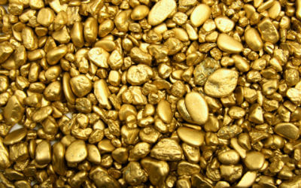

Slide 3

In this Smart Lesson, you will learn about minerals, the building blocks of rocks.
We will focus on minerals that have economic value; that means they bring in lots of money!

Slide 4
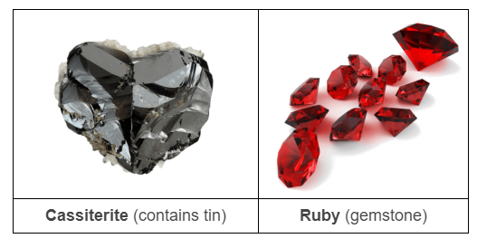
Rocks are made up of minerals.
Most rocks are made up of multiple minerals. Some of them are very useful because we get important metals from them, such as tin and iron. Some of them look very pretty and are used in jewellery as gemstones!

Slide 5
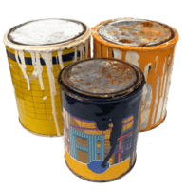

Some minerals contain lots of metal. They provide the tin that cans are made from, the aluminium in your parents' car and the copper in ordinary wires.
Rocks containing such valuable minerals are called ores. An ore is a rock that contains useful materials.

Slide 6
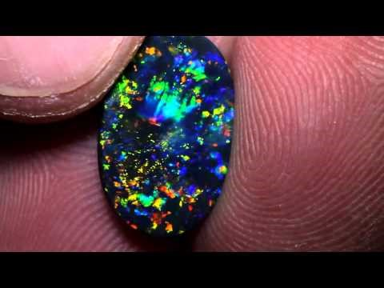

Slide 7

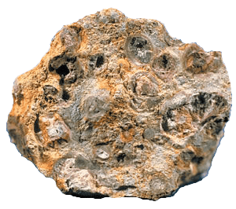
Rocks that contain valuable metals are called ores. For instance, the ore bauxite is very rich in aluminium, a metal which is used to build cars and trucks.
Australia provides almost one-third of the world's bauxite!

Slide 8
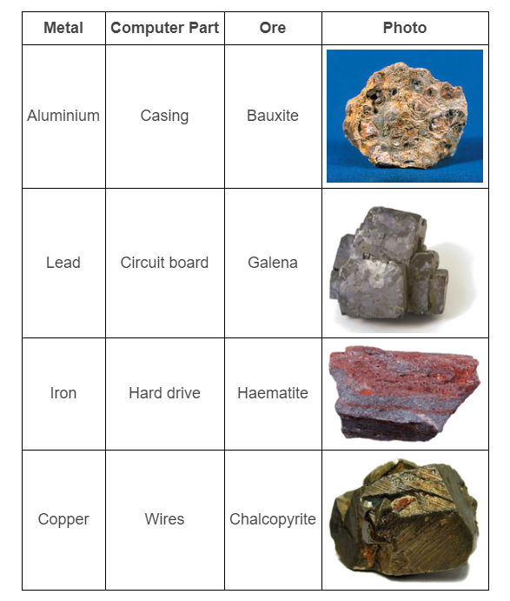

Slide 9
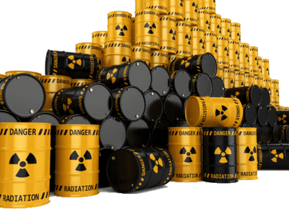
Although mining produces useful resources for society, it gets a lot of bad press. This is because the act of mining can have a huge negative impact on the natural environment. It's inevitable; you have to dig a giant hole in the ground to get ores out!
Nowhere is this more obvious than in uranium mining.

Slide 10
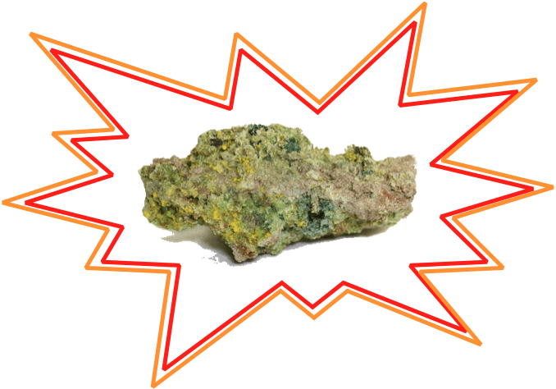
Uranium is a heavy, radioactive element found in rocks.
Radioactive things give off radiation that can pollute water, cause cancer and harm living things in other ways. Radiation is made up of energy and particles that are released when one element (e.g: uranium) naturally decays into another element (e.g: thorium).

Slide 11
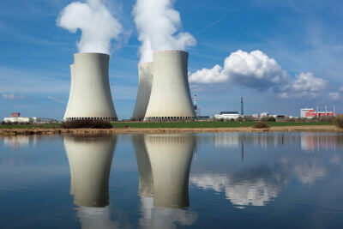
This stuff sounds dangerous, so why do we mine it?
Like coal, uranium is used as a fuel. Unlike coal, it is a type of nuclear fuel, which means it produces radioactive waste in power stations. In 2012, nuclear fuel provided over 10% of the world's electricity. That's a lot of power!

Slide 12
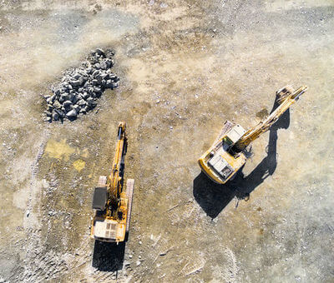
Australia produces 8.9% of all the uranium used on Earth for fuel.
Now we're going to look at three places where that uranium is mined. Then we will think about the consequences for people and for the environment.

Slide 13
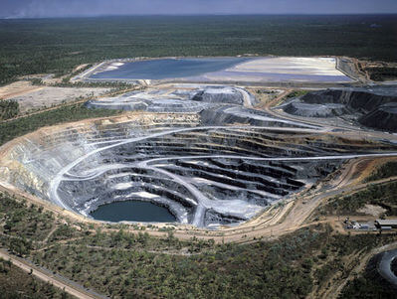
Opencast mining is used to extract uranium ore that is close to the Earth's surface.

Slide 14
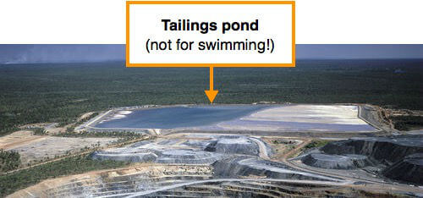
Uranium from Ranger has been shipped to nuclear power plants in Europe, Asia and North America. What's left behind are the radioactive waste products, which are stored at the bottom of a special tailings pond.

Slide 15
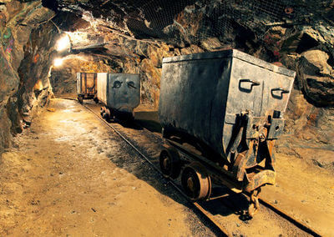
Underground mining techniques are used at Olympic Dam in South Australia. It's home to the largest known uranium deposit on the entire planet!
With deep tunnels, train tracks and old-timey carts, miners at Olympic Dam have been bringing uranium to the surface since 1988.

Slide 16

Remember how underground mining tends to be more hazardous than opencast mining? When uranium is the thing being mined, there's a whole new level of danger!
In the tunnels under Olympic Dam, miners have to wear protective suits to avoid being harmed by the radiation. In the future, this work might be done by robots instead because they don't get radiation sickness.

Slide 17

At Beverley Mine in the Flinders Ranges, miners use a different technique to extract uranium. They pump acid into it!
The acid in question is sulfuric acid, the same chemical that does this to a kitchen sponge:

Slide 18
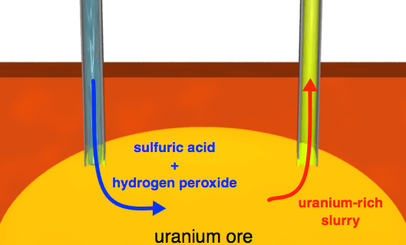
Extracting the uranium using acid is called in situ mining. It means people don't have to go underground at all!
Instead, a few holes are drilled into the ground. A mixture of sulfuric acid and hydrogen peroxide is then pumped down the drill holes. It dissolves the ore below and returns to the surface as a uranium-rich slurry.

Slide 19

In some ways, in situ mining is safer than either opencast or underground mining. It doesn't require a huge pit or a deep tunnel to be cut, so there's no need for heavy machinery or explosives!
On the other hand, the slurry that comes up at Beverley Mine is radioactive, corrosive and extremely acidic. Stopping leaks and spills has always been a top priority for those working here!

